Slide 1
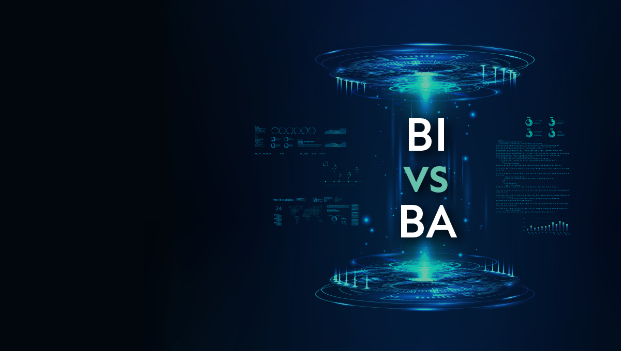
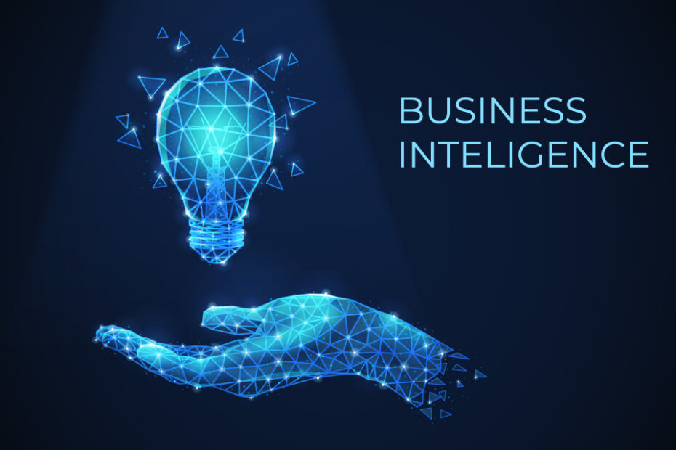
Business intelligence (BI) refers to the technologies, tools, and processes used to collect, analyze, and present data in a way that helps organizations make informed business decisions.
BI systems gather data from various sources, transform it into actionable insights through reporting, dashboards, and data visualization, and support strategic planning and operational improvements.
Business Intelligence
Team members:
1. Ranveer Ghorpade
2. Pratiksha Patil
Guided by
Ms. Ashwini Powar

Slide 2
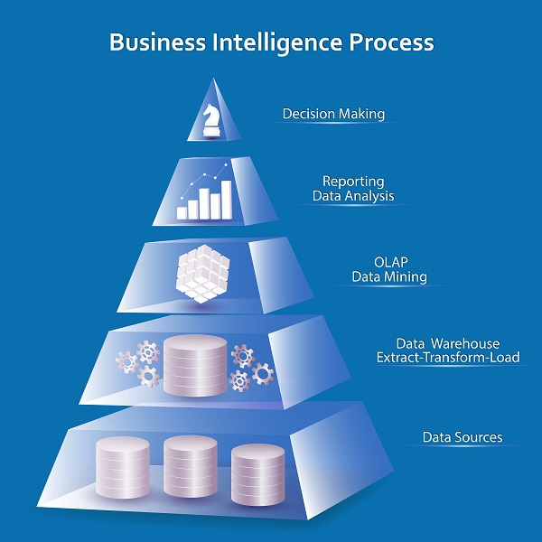
Data Collection: Gathering data from various internal and external sources, including databases, CRM systems, and external data feeds.
Data Integration: Combining and organizing data into a unified structure, often through ETL (Extract, Transform, Load) processes.
Data Analysis: Using tools like data mining, querying, and statistical analysis to extract meaningful insights.
Data Visualization: Presenting data through dashboards, charts, and reports for easy interpretation.
Decision Making: Using insights to guide strategic and operational decisions, improving business outcomes.
Business Intelligence
Business intelligence (BI) refers to the technologies, tools, and processes used to collect, analyze, and present data in a way that helps organizations make informed business decisions.
BI systems gather data from various sources, transform it into actionable insights through reporting, dashboards, and data visualization, and support strategic planning and operational improvements.
Business Intelligence Process:
Business Intelligence Process:

Slide 3
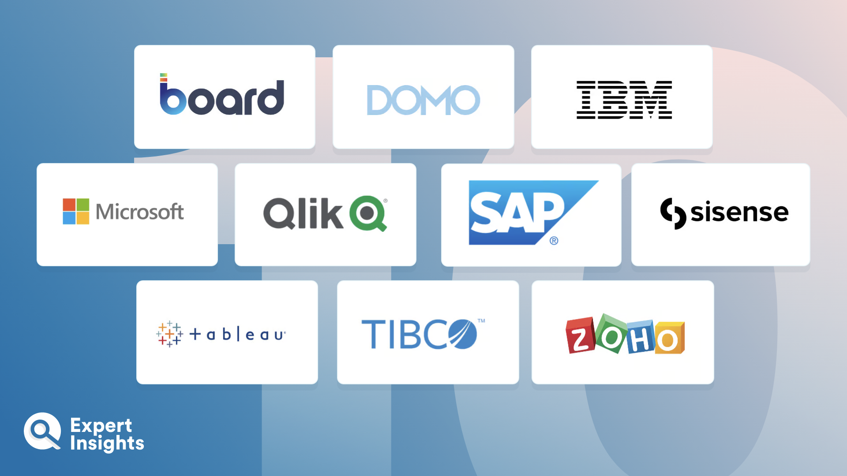
Tableau: A powerful data visualization tool that helps create interactive dashboards and reports.
Power BI: A Microsoft tool for connecting, visualizing, and sharing data with robust integration with other Microsoft products.
Qlik Sense: A self-service BI tool that provides data visualization and discovery with a focus on real-time analytics.
SAP BusinessObjects: A comprehensive suite of BI tools for reporting, analysis, and data visualization.
Domo: A cloud-based platform combining data visualization with real-time collaboration features.
Sisense: A full-stack BI platform that allows for complex data analysis with strong embedding capabilities.
Business Intelligence Tools:
Business Intelligence Process
Data Collection: Gathering data from various internal and external sources, including databases, CRM systems, and external data feeds.
Data Integration: Combining and organizing data into a unified structure, often through ETL (Extract, Transform, Load) processes.
Data Analysis: Using tools like data mining, querying, and statistical analysis to extract meaningful insights.
Data Visualization: Presenting data through dashboards, charts, and reports for easy interpretation.
Decision Making: Using insights to guide strategic and operational decisions, improving business outcomes.

Slide 4
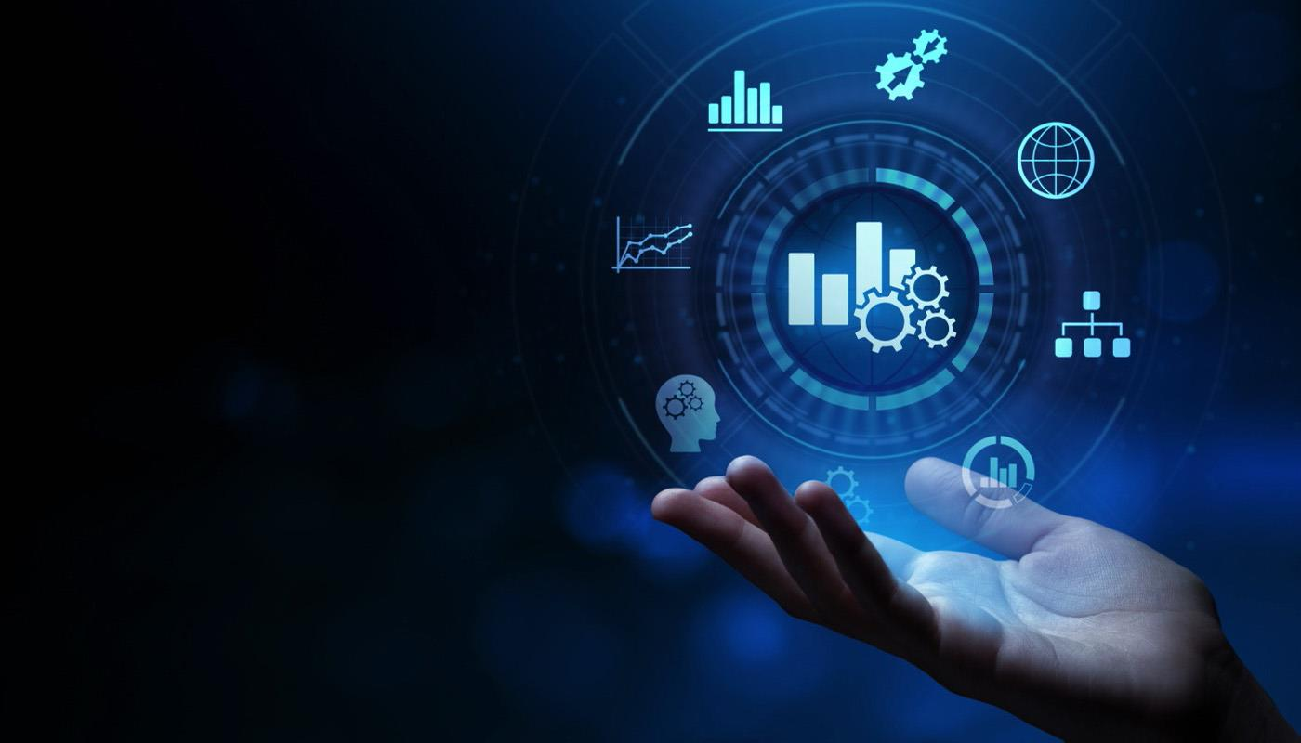
Data Collection: Retail company gathers sales, inventory, and customer data from multiple sources.
Data Analysis: Use BI tools (e.g., Power BI, Tableau) to analyze trends in customer purchases and product performance.
Insights: Identify best-selling products, low-performing items, and customer buying behaviors.
Actionable Decisions: Optimize stock levels, adjust pricing, and launch targeted marketing campaigns.
Outcome: Improved sales, better inventory management, and increased profitability.
Example:
Business Intelligence Tools:
Tableau: A powerful data visualization tool that helps create interactive dashboards and reports.
Power BI: A Microsoft tool for connecting, visualizing, and sharing data with robust integration with other Microsoft products.
Qlik Sense: A self-service BI tool that provides data visualization and discovery with a focus on real-time analytics.
SAP BusinessObjects: A comprehensive suite of BI tools for reporting, analysis, and data visualization.
Domo: A cloud-based platform combining data visualization with real-time collaboration features.
Sisense: A full-stack BI platform that allows for complex data analysis with strong embedding capabilities.

Slide 5
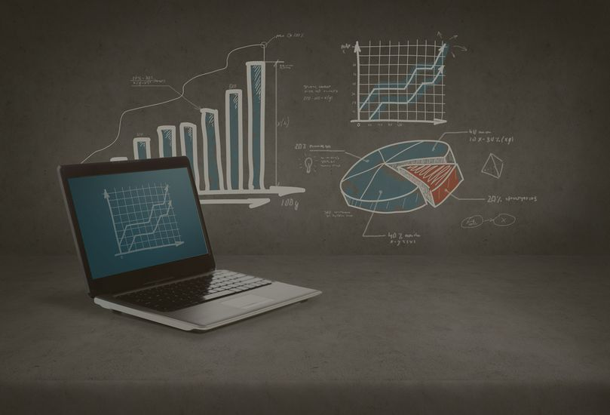
Business Analytics:
Example:
Data Collection: Retail company gathers sales, inventory, and customer data from multiple sources.
Data Analysis: Use BI tools (e.g., Power BI, Tableau) to analyze trends in customer purchases and product performance.
Insights: Identify best-selling products, low-performing items, and customer buying behaviors.
Actionable Decisions: Optimize stock levels, adjust pricing, and launch targeted marketing campaigns.
Outcome: Improved sales, better inventory management, and increased profitability.
Business analytics refers to the practice of using data, statistical analysis, and predictive modeling to identify patterns, trends, and insights that help businesses make data-driven decisions.
It focuses on interpreting historical data and using it to forecast future outcomes, optimize operations, and improve strategic planning..

Slide 6
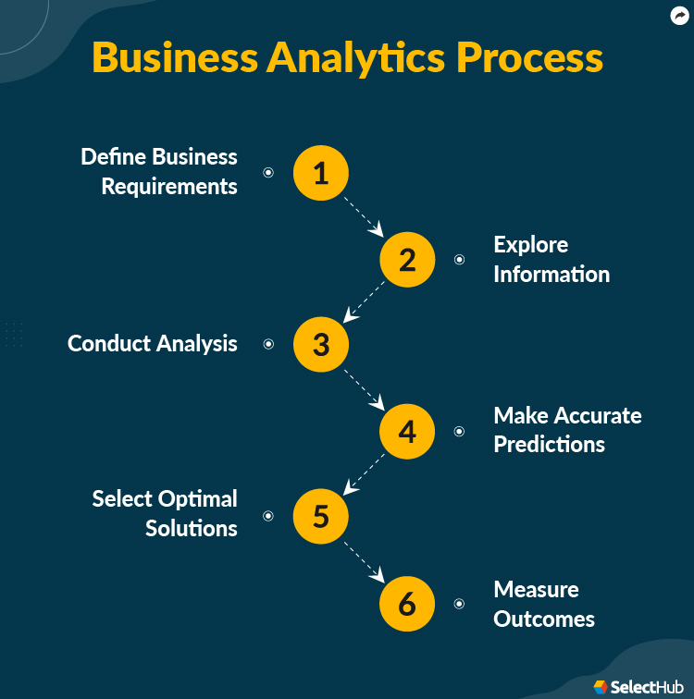
Define Business Requirements: Identify the specific goals and objectives the analysis will address.
Explore Information: Gather and examine relevant data to understand the current situation.
Conduct Analysis: Analyze the data using statistical methods to uncover insights.
Make Accurate Predictions: Use models to predict future trends and outcomes.
Select Optimal Solutions: Choose the best course of action based on the analysis and predictions.
Measure Outcomes: Track and evaluate the results to ensure the solutions are effective.
Business Analytics Process:
Business Analytics:
Business analytics refers to the practice of using data, statistical analysis, and predictive modeling to identify patterns, trends, and insights that help businesses make data-driven decisions.
It focuses on interpreting historical data and using it to forecast future outcomes, optimize operations, and improve strategic planning..

Slide 7
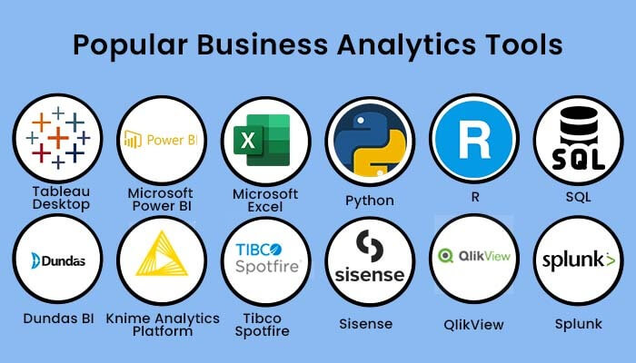
Business Analytics Tools:
Business Analytics Process:
Define Business Requirements: Identify the specific goals and objectives the analysis will address.
Explore Information: Gather and examine relevant data to understand the current situation.
Conduct Analysis: Analyze the data using statistical methods to uncover insights.
Make Accurate Predictions: Use models to predict future trends and outcomes.
Select Optimal Solutions: Choose the best course of action based on the analysis and predictions.
Measure Outcomes: Track and evaluate the results to ensure the solutions are effective.
R: An open-source programming language widely used for statistical computing and data visualization.
Python: A versatile programming language with libraries like Pandas, NumPy, and SciPy for data analysis and machine learning.
Excel: A commonly used tool for basic data analysis, reporting, and visualizations.
QlikView: A BI and analytics platform for data visualization and discovery.

Slide 8
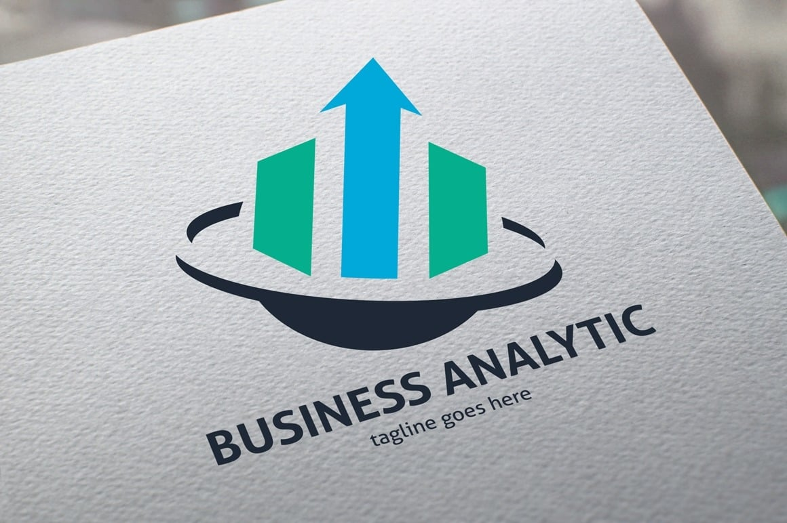
Business Analytics Tools:
R: An open-source programming language widely used for statistical computing and data visualization.
Python: A versatile programming language with libraries like Pandas, NumPy, and SciPy for data analysis and machine learning.
Excel: A commonly used tool for basic data analysis, reporting, and visualizations.
QlikView: A BI and analytics platform for data visualization and discovery.
A hotel chain uses business intelligence tools to analyze customer data from bookings, reviews, and social media. By visualizing trends in customer preferences, seasonal booking patterns, and competitor pricing, the management can make data-driven decisions such as adjusting room rates, personalizing marketing campaigns, and improving customer service strategies, ultimately enhancing guest satisfaction and increasing revenue.
Example:

Slide 9
Example:
A hotel chain uses business intelligence tools to analyze customer data from bookings, reviews, and social media. By visualizing trends in customer preferences, seasonal booking patterns, and competitor pricing, the management can make data-driven decisions such as adjusting room rates, personalizing marketing campaigns, and improving customer service strategies, ultimately enhancing guest satisfaction and increasing revenue.
Thank You.

Slide 10
Thank You.

